Slide 1

A two-step training of binary ReRAM array to recover accuracy degradation
due to statistical variabilities
Graduate School Information, Production and Systems
Waseda University
CHEN Zian
2021.04.14
Notes:
Good afternoon everyone, I am CHEN ZIAN. My research theme is A two-step training of binary ReRAM array to recover accuracy degradation due to statistical variabilities.

Slide 2
Outline
Background
Purpose
Method
Results
Analysis
Conclusion
Future Work
Notes:
The First part is my research background and purpose.

Slide 3


Deep Neural Network (DNN)
Hidden layer
Input
x0
Y1
Output
X1
ω0
X2
x1
ω1
$$Z_{j}=\sum_{i=0}^{m}{X_{i}ω_{ij}}+b$$
$$Y_{j}=f(Z_{j})$$
$$Y_{j}$$
ωi
xi
Xi
Yj
xm
ωm
Xm-1
Xm
Yn
Weight1
Weight2
Application field:
Automatic drive
Pattern recognition
Biomedical signal detection
X: input (floating point number),
ω: weight (floating point number),
Y: hidden layer's output and output layer's input,
f(Zj): activation function.
Notes:
This picture is a deep neural network model. It has three basic layers. Input layer, hidden layer and output layer. Every layer has many neurons In the frame, a neuron connects to every inputs from the upper layer and next layer. In this neuron, the sum of the multiplication of inputs and weights can be obtained and then through the activation function. The output of the neuron can be next layer’s input.

Slide 4
Comparation of DNN and Binary Neural Network (BNN)
 | DNN | BNN
Merit | High accuracy | High calculation speed High tolerance for fluctuation (in hardware)
Demerit | Low calculation speed Low tolerance for fluctuation (in hardware) | Low accuracy
Binary neural network (BNN) is a kind of special NN, weights and inputs are constrained to either +1 or -1. So the size of BNN will be larger than DNN if a high accuracy is wanted.
Notes:
BNN is a kind of special DNN. Weights and inputs are constrained to either +1 or -1. The advantage of DNN is high accuracy, but rather then BNN，the training speed and tolerance for fluctuation in hardware is low. Because of the binary weights and inputs, the BNN’s accuracy is low. But robustness and training speed will be high.

Slide 5
Binary Deep Neural Network (BNN)
Input Layer
Neuron
Hidden Layer
Neuron
Output Layer
Neuron
Output:
Integer
Weight:
1 or -1
Weight:
1 or -1
Input: 1 or -1
Step 1
Step 2
Step 1
Weight:
1 or -1
Weight:
1 or -1
Output:
1 or -1
Output:
1 or -1
Step 1: sum of the multiplication between weight and input. Result is an integer.
Step 2: activation function. Input is an integer. Output is 1 or -1.
[1] M. Courbariaux, I. Hubara, D. Soudry, R. El-Yaniv, and Y. Bengio, “Binarized neural networks: Training deep neural networks with weights and activations constrained to+ 1 or-1,” arXiv preprint arXiv:1602.02830, 2016.
Notes:
From the process picture, we can see the value of weight and input are I or -1. The step 1 is to get the product sum. In the BNN, it will be integer. Step 2 is an activation function. It will make the integer input become to binary output.

Slide 6







Activation Function in the BNN
In the Forward Propogation
Sign Function
+1 if
$$x≥0,$$
$$y=Sign(x)=$$
-1 otherwise
In the Back Propogation
+1 if
$$x≥1,$$
if
$$y=Binary_tahn(x)=$$
$$x$$
$$−1≤x≤+1$$
-1 if
$$x≤−1$$
In the back propogation, if using Sign Function as an activition function, gradient will always be 0. Weights can't be updated . So Binary_tahn Function is used in the back propogation.
Notes:
Activation Function is an important part in the DNN, Usually it can be ReRU fuction or Sigmoid Function. But in BNN, the activation function is different. In the forward propogation, Sign function is used because the output and next layer’s input are binary. But in the back propogation, if using Sign Function as an activation function, gradient will always be 0. weights can't be updated. So Binary_tahn Function is used in the back propogation.

Slide 7
In-memory Computing
Memory
Memory with Embedded Computation
Output
Huge data transfer from/to memory
Input
Buffer
Input
Buffer
CPU
Compute
Output
In-memory Computing
von Neumann Architecture
von Neumann Architecture → In-memory Computing
High power consumption → Low power consumption
Low speed → High speed
Notes:
In the von Neumann architecture, computation and memory are separate units: the computation unit reads data from memory and stores it back to memory after the computation is completed. The processor/accelerator chip and the main memory are two independent modules, which will leads to the generation of memory wall. In-memory computing is directly processing data in the memory. It will improve the speed and reduce the power consumption. My task is to design a deep neural network accelerator.

Slide 8
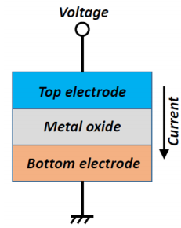
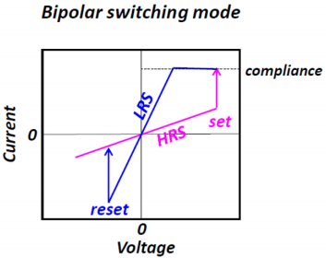
ReRAM
ReRAM is a kind of non-volatile emerging memory ,which is composed of two electrodes and a middle metal oxide.
Its resistance state is decided by the length of conductive filament or the number of conductive filaments in the metal oxide layer.
By applying programming voltage to a ReRAM device, its resistance can be switched between different states.
Notes:
ReRAM is one of non-volatile emerging memories, which is composed of two electrodes and a metal oxide sandwiched in between. Its resistance state is decided by the length or the number of conductive filaments in the metal oxide layer. By applying programming voltage to a ReRAM device, its resistance can be switched between different states.

Slide 9
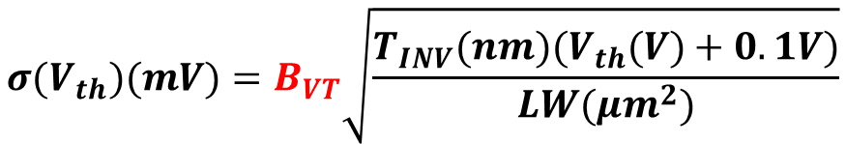
CMOS Process Variation
$$σ(V_{th})(mV)=B_{VT}\sqrt{\frac{T_{INV}(nm)(V_{th}(V)+0.1V)}{LW({μm}^{2})}}$$
In nmos, B_{VT}=2.5
[2] K. Takeuchi et al., "Understanding Random Threshold Voltage Fluctuation by Comparing Multiple Fabs and Technologies," 2007 IEEE International Electron Devices Meeting, Washington, DC, 2007, pp. 467-470.
Notes:
In the fabrication process. The threshold voltage will have a random fluctuation accounting for dopant fluctuation. These fluctuations are following the Gaussian distribution. The standard deviation can be predicted by using this equation. A coefficient Bvt is a amonst constant in different technology node. In the nmos transistor, Bvt equals to 2.5. With the technology node developing. The sigama Vth become higher.

Slide 10
Purpose
Propose a training method to mitigate the hardware fluctuation effect on accuracy of BNN accelerator.
Step 1
Design BNN in hardware by using in-memory computing architecture.
Step 2
Analyze influence of device fluctuations on accuracy of the BNN crossbar array
Step 3
Propose a method to mitigate the influence of fluctuations.
Notes:
My purpose is to mitigate the bad effect of fluctuation. There are three steps. The first one is to Design the BNN in hardware by using in-memory computing architecture. And then evaluate the influence of device Fluctuations on Accuracy of BNN Crossbar Array. Third step is to propose a method to mitigate the device fluctuation.

Slide 11
Outline
Background
Purpose
Method
Results
Analysis
Conclusion
Future Work
Notes:
Presentation title:

Slide 12
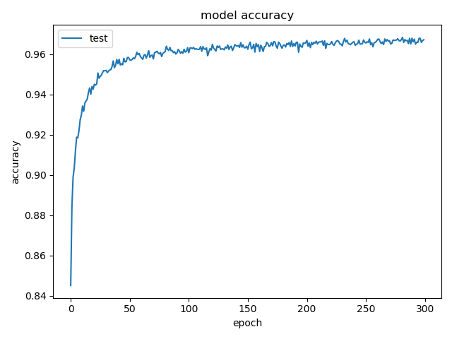
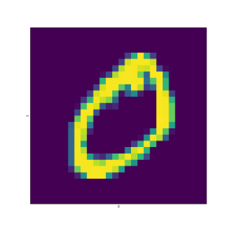
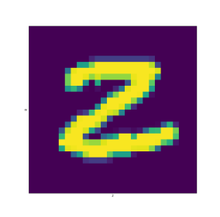
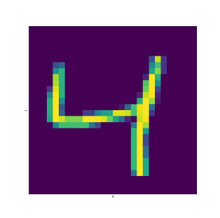

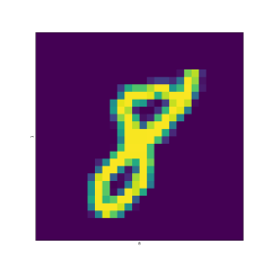
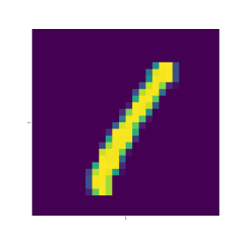
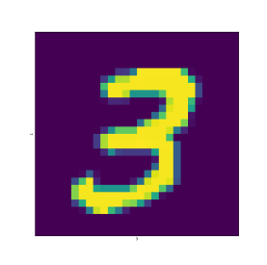
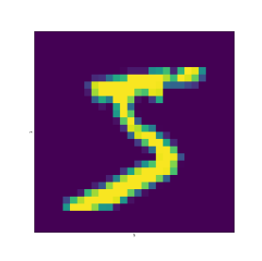

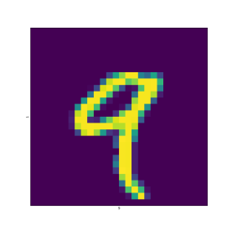
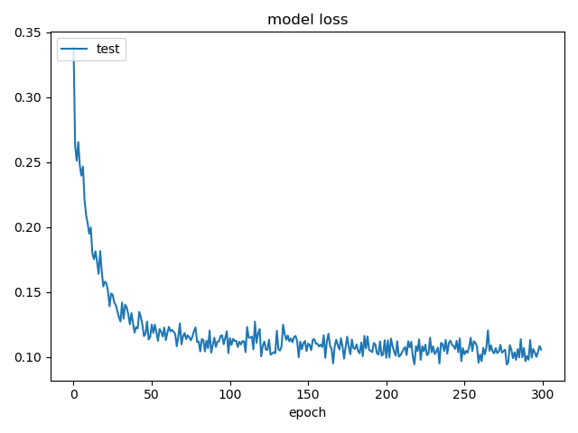






Accuracy and Loss of the BNN in Test (Software)
MNIST Datasets
BNN:784*512*512*512*10
Binary Input
of MNIST
Input
Hidden layer
512
512
512
$$X_{1}$$
784
$$Y_{1}$$
Output
10
$$X_{i}$$
$$Y_{j}$$
$$X_{784}$$
$$Y_{512}$$
Test Accuracy: 96.74%
Test loss: 0.1022
1
Weights:
1
Input/Output:
-1
-1
Integer
Notes:
MNIST is a handwriting number datasets. Every sample is a grayscale image with 784 points (784 inputs). And every point's gray value is from 0 to 255. The size of the Binary neural network is 784 times 512*512*512*10. The test accuracy is 96.67%

Slide 13
Storage Cell (Synapse)
BL
WL
M0
WL and WLb's voltage are inputs.
When R0 is LRS and R1 is HRS, weight is 1, when R0 is HRS and R1 is LRS, weight is -1.
Output Value=x*w
VDD
R0
R1
M1
WLb
BL BL Output / Output Value Current |  |  |  | Cell Resistance State (weight)
 |  |  |  | 1 | -1 | Value
 |  |  |  | LRS | HRS | R0
 |  |  |  | HRS | LRS | R1
WL Voltage (activation) | 1 | VDD | GND | 1/High | -1/Low
 | -1 | GND | VDD | -1/Low | 1/High
 | Value | WL | WL
In my work, HRS=100kΩ
LRS=5.3kΩ
[3] Y. Guan, T. Ohsawa, “Co-Design of Binary Processing in Memory ReRAM Array and DNN Model Optimization Algorithm,” IEICE Trans. Electron., vol. E103-C, no. 11, pp.685-692, Nov. 2020.
Notes:
This is the storage cell in the circuit and it can store binary weights. It composed of two transistors, two ReRAM devices, WL and WLb's voltage are inputs and Bit lines current is output. The following table shows the relatoinship between the output and Cell resistance and WL input voltage. The output equels to Cell resistance state’s value times Wl input voltage’ value. In the storage cell, High resistance is 100k Ohm, Low reistance is 5.3k Ohm.

Slide 14
Sign Function (Neurons)
BL
Dummy BL (DBL)
HSPICE simulation DC waveform
VDD
VDD
VDD
VDD
m1
m2
m5
m7
m9
DL
IN+
IN-
m3
m4
m6
m8
m10
G
G
G
-
G
_
DBL
DL
IN+
IN-
+
BL
V_{DBL}=0.6626V (BL Value=0)
Differential amplifier (DA)
CMOS inverters
Notes:
A differential amplifier and three cmos inverter are used to achieve activation function Sign function. Dummy bl’s voltage is 0.6626 volt, which is corresponding to BL value is 0. BL’s voltage compare with dummy bL’s voltage. When BL voltage is large than dummy BL voltage, output is high, ans vise versa, output is low. On the right is the DC simulation result, which shows DL, INV+, INV-’s voltage when BL voltage change from 0 to 1.8V. , INV+ and INV- will be next array’s inputs because their binary value is obvious.

Slide 15
ReRAM Array
A dummy BL connects to the equal number of weight 1 cells and weight -1 cells.
Every input of the cell which connects to the dummy BL is corresponding to binary number 1. So the output of dummy BL is 0.
Notes:
This is the stucture of the ReRAM Array. A dummy BL connects to the equal number of weight 1 cells and weight -1 cells. Every input is corresponding to binary number 1. So the output of dummy BL is 0. According to the Kiffof’s Law. BL’s current is the sum of every cell’s current. The current can be translated to load voltage and every Bit lines’ voltage will be compared with the dummy bit lines voltage in the differential amplifier.

Slide 16
ReRAM Array Architecture
ReRAM Array
ReRAM Array
784 WLs
10 BLs
Input
Output
1st
4th
512 BLs
512 WLs
Hidden Layer 1
Hidden Layer 3
ReRAM Array
Hidden Layer 2
ReRAM Array
512 BLs
512 WLs
2nd
3rd
512 WLs
512 BLs
Notes:
This is ReRAM Array Schemetic. There are four ReRAM Arrays for 5 layers.

Slide 17
Simulation Waveforms Result for Outputs
Hardware circuit accuracy: 96.75% (500 samples simulated by FineSim SPICE)
Notes:
This graph shows the simulation waveforms of a sample 0 which is picked up randomly from the test dataset. and the curves in Fig. 4 are the BL voltages of the final classification layer. Since the Vout0’s voltage is the highest, the BNN circuit can recognize this sample successfully. The access time of this BNN accelerator is about 60ns, which has an efficient performance. Twenty samples from each number (totally 500 samples) are picked up randomly from the test dataset and simulated by FineSim SPICE. The validation accuracy of 96.75% in hardware simulation is reached.

Slide 18

Vth Fluctuation in D/A
Differential Amplifier
Fabrication fluctuations of MOSFET devices effect the circuit performence
BL
VDD
Dummy BL
Fluctuation
$$σ_{Vth}$$
m1
m2
DL
m3
m4
In this work, variations (∆Vth) of MOSFET m3 and m4's Vth in 1546 amplifies are considered and these ∆Vth follow the Gaussian distribution with average=0 and standard deviation σVth
Notes:
In the fabrication process, the fluctuation of the MOSFET devices always effect the circuit performance. In this work, variations (∆Vth) of MOSFET m3 and m4's Vth in 1546 amplifies are considered and these ∆Vth follow the Gaussian distribution with average=0 and standard deviation σVth.

Slide 19
Concept of Off-line Training
Accuracy:
High
Software (S/W)
training
Training Datasets
Test Datasets
Conductance (weights)
Inference Accelerator chip (H/W)
Including Vth fluctuation ( σVth)
Accuracy:
Low
Test Datasets
Software
Hardware
Notes:
Off-line training means training without hardware information. Although a high software accuracy can be obtained. When transfer the model to the hardware, the hardware will reduce because of devices fluctuation.

Slide 20
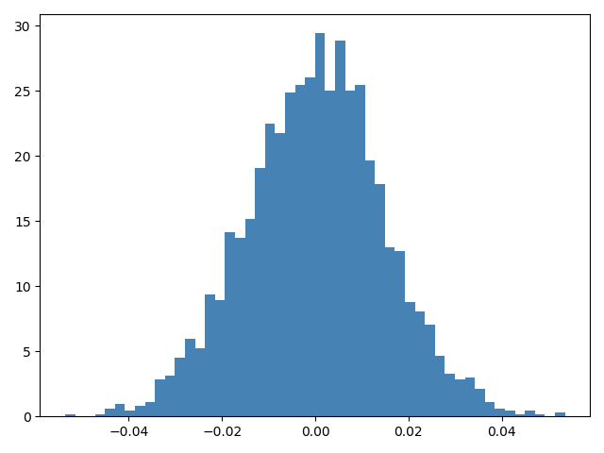
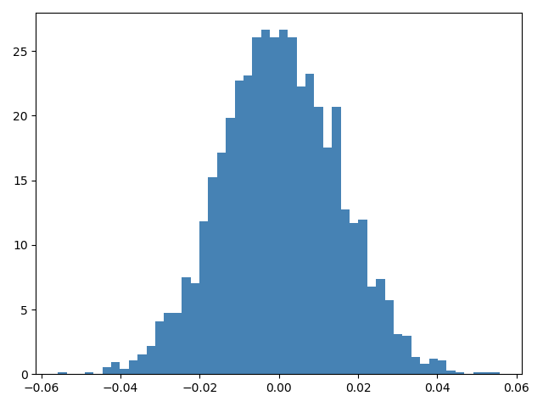
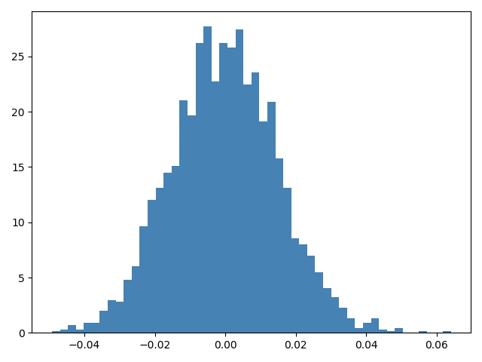

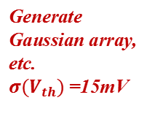
Simulation Process for Simulating Fluctuation
Fluctuation Generation
Simulation
Accuracy Check
Chip1
3092 models
Finesim
SPICE
Simulation
Generate Gaussian array, etc. $σ(V_{th})$=15mV
Chip2
3092 models
Finesim
SPICE
Simulation
Shell Script
(check accuracy)
Numpy
Function
(Python)
For each chip, 100 samples are simulated
# NFETs in DAs = 3092
For each$σ(V_{th})$, 5 distributions are transformed to 5 chips
Chip5
3092 models
Finesim
SPICE
Simulation
Notes:
In order to simulate the influence of fluctuation on the neural network accelerator, I used these three processes.First, the Numpy function in Python is used to generate an array that obeys normal distribution, and then the values in the array are converted to the values of Vth in the model, and 3092 models are generated correspondingly.These 3092 models are a group.I generated five chips altogether.Each chip corresponds to an accelerator circuit.The second step is to simulate each accelerator circuit, and 100 test samples corresponding to each accelerator are randomly selected from the data set.The third part is to get the accuracy of the circuit. I wrote a shell script to calculate the accuracy of the simulation results.

Slide 21
Hardware Accuracy Result under Fluctuation
Notes:
This figure shows the hardware accuracy with fluctuction of gaussian distribution. The accuracy decreases rapidly with the increase of the fluctuation standard deviation

Slide 22
Concept of Co-design
Accuracy
High
Software (S/W)
training
Training Datasets
Test Datasets
Optimum conductance (weights)
Hardware Fluctuation Information
Inference Accelerator chip (H/W)
Including Vth fluctuation ( σVth)
Accuracy:
Medium
Test Datasets
Software
Hardware
[3] Y. Guan, T. Ohsawa, “Co-Design of Binary Processing in Memory ReRAM Array and DNN Model Optimization Algorithm,” IEICE Trans. Electron., vol. E103-C, no. 11, pp.685-692, Nov. 2020.
Notes:
Co-design is a method to mitigate the bad effect of the fluctuation. It means injecting the hardware information to the software. After training, the optimized weights adapt to hardware fluctuations and improves robustness.

Slide 23

∆VBL (∆Vth) in H/W and BL Value in S/W
BL
Cells
BL
DA
WL₁
synapsis
Cell
X1
WLb₁
Neuron
X2
WL₂
BL Value: Sum of the product between weight and input
WLb₂
Xi
Weight
Sign(BL Value+Bias)
Xn-1
WL_{n}
Xn
WLb_{n}
NFET Vth Fluctuation (ΔV_{th} or ΔV_{BL} )
Hardware
Software
BL Voltage
(V_{BL})
DA
BL Voltage (V_{BL})
BL Value
R_{load}
ΔV_{BL}
Bias
Notes:
Left is hardware’s BL and cells. Right is software’s synapsis and neuron. The storage cells in the hardware are corresponding to synapsis in the software. BL in hardware realizes the function of product sum in software neuron. So the BL voltage is corresponding to BL Value. The threshold voltage fluctuation of NFET in the SA can be regarded as datVBL brought to BL voltage. Since SA implements the Sign function, DATVBL corresponds to BIAS

Slide 24

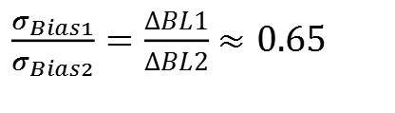

∆VBL (∆Vth) in H/W and BL Value in S/W
Off-line training
Co-design
Activation Function
$$Sign(x)$$
$$Sign(x+bias)$$
Bias1 is the bias between first to second layers' bias.
Bias2 is the bias in other layers
2nd , 3rd, 4th Arrays
(512 cells/BL)
1st Array
(784 cells/BL)
$\frac{σ_{Bias1}}{σ_{Bias2}}=\frac{ΔBL1}{ΔBL2}$ $≈0.65$
Notes:
The transformation relationship between VBL fluctuation and bias can be determined according to the figure below, this diagram shows the simulation results for the relationship between BL mathematical (multiply-accumulate) value and physical BL voltage. σbias1 is the input layer’s (784 cells/BL) σbias and σbias2 is the hidden layers’σbias. When the corresponding to the same σVth. From the diagram, we can get that σbias1 and σbias2 ‘s value are different. σbias2 equals to 0.65 times σbias1.

Slide 25
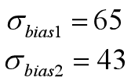
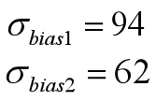

Co-design Parameter Setting
Training Datasets: 60,000 samples
Batch 1:
128 samples
Batch 2:
128 samples
Batch 3:
128 samples
Batch 469:
128 samples
BNN Training
BNN Training
BNN Training
BNN Training
Random sampling
1 iteration
$$σbias$$
1 epoch
Epoch=20000
Software Test Accuracy=80.99%
Learning rate=10⁻³~10⁻⁴
Epoch=20000
Software Test Accuracy=66.79%
Learning rate=10⁻³~10⁻⁴
Notes:
This diagram shows Co-design’s training process. The training dataset has 60000 samples. batch size is 128. A batch’s training is called an iteration. The weights will be updated after each iteration. And the biases are randomly picked up from Gaussin dietributon to each batch, which means that in different batch, the biases will be different. So the co-design’s optimum weights can be applied to each BNN accelerator chip in the same manufacture line. I did two co-design training. The difference between these two groups is siguma bias’s value. the first group software test accuracy is 80.99%. the second group’s software test accuracy is 66.79%.

Slide 26
Hardware Accuracy of Co-design
Notes:
Then I transform the optimized weights of co-design to hardware and simulate. The hardware accuracy is shown in graph. One spot contains five hundred samples of the simulation. The accuracy recovers when the fluctuation is large. However, Although the co-design improves the accuracy, it is still insufficient.

Slide 27
Two-step training
BNN (co-design training)
Chip1, Chip2, Chip3, Chipn: Medium Accuracy
Optimum weights
Chip1
Chip2
Chip3
Chipn
Measured Vth Group1
Measured Vth Group2
Measured Vth Group3
Measured Vth Groupn
Training dataset
Training dataset
Training dataset
Training dataset
Individual
Retraining1
Individual
Retraining2
Individual
Retraining3
Individual
Retrainingn
Chip1:High Accuracy
Chip2: High Accuracy
Chip3: High Accuracy
Chipn: High Accuracy
Notes:
To further recover the accelerator’s accuracy. An individual retraining is proposed. the optimum weights of the co-design are used as initial weights in individual retraining.In the individual retraining process, the SAs’ offset voltages of each chip are measured, and then transformed to the biases. After retraining, High accuracy can be obtained.

Slide 28
Unfixed Ratio Retraining Method
1st Array
(784 cells/BL)
Unfixed ratio
BLin Voltage
BLother Voltage
Notes:
In individual retraining, the most important thing is to accurately convert the measured offset voltage into bias in software training. Because BL voltage and the BL value relationship curve is not linear, so we put forward a fixed ratio method, the conversion coefficient will change with the BL value changing, Because the variable ratio can better reflect the curve of the relationship curve, the accuracy of the prediction will be high. First, I fit these two curves to get the following two fitting functions.

Slide 29


Unfixed Ratio Retraining Method
$$Unfixed_ratio1=4×10^{−13}x^{4}−4×10^{−10}x^{3}+3×10^{−7}x^{2}−0.0004x+0.3172$$
$$Unfixed_ratio2=4×10^{−12}x^{4}−2.8×10^{−9}x^{3}+1.2×10^{−6}x^{2}−0.0008x+0.4918$$
The Vth fluctuation of pair of nmos in DAs
$${ΔV}_{thj}=V_{thj}−\overline{V_{th}}$$
$${∆V}_{thj}^{′}=V_{thj}^{′}−\overline{V_{th}^{′}}$$
$${bias}_{1j}=−\frac{{1000×∆V}_{thj }\left[mV\right]}{{Unfixed_ratio}_{1}}+\frac{1000×{∆V}_{thj}^{′}\left[mV\right]}{0.3177} \left(j=1, ⋯, 784\right).$$
$${bias}_{2j}=−\frac{{1000×∆V}_{thj }\left[mV\right]}{{Unfixed_ratio}_{2}}+\frac{1000×{∆V}_{thj}^{′}\left[mV\right]}{0.4919} \left(j=1, ⋯, 512\right).$$
Training Parameter:
Learning_rate=5*10⁻³
Epoch=1
Notes:
In the unfixed ratio method. The unfixed ratio is the gradient of these two curves’ fitting functions. Unfixed_ratio1 is input layer’s coefficient. Unfixed_ratio2 is other layer’s coefficient. And the Vths of pairs of NFETs are necessary to be measured. Data Vth can be obtained by reducing measured Vth by average Vth. In the retraining process, I set learning rate as 5*10-3,and epoch number is one.

Slide 30
Hardware Accuracy of Fixed Ratio Method
One time simulation (100samples each spot)
Notes:
After transform the retraining’s optimized weights to the accelerator and simulation by finesim. The hardware accuracy of fixed ratio method is shown as this graph. large accuracy recoveries.

Slide 31
Outline
Background
Purpose
Method
Results
Analysis
Conclusion
Future Work
Notes:
Presentation title:

Slide 32
Conclusion
A BNN ReRAM array is designed which achieves MNIST identification with 96.75% hardware simulation accuracy.
The accuracy of BNN array decreases to 20% when σ_{Vth}=30mV.
The co-design method will recover 20% when σ_{Vth}=20mV and 10% when σ_{Vth}=30mV in the hardware.
We proposed a two-step training method which could achieve much higher accuracies than the co-design with a minimum retraining cost (1 epoch) added. large accuracy recoveries (55% at σ_{Vth}=30mV) are observed.
28
Notes:
Presentation title:

Slide 33
Future Work
Improve the accuracy of two-step retraining
Analyze the power consumption
Notes:
Presentation title:

Slide 34
Thank you

Slide 35
Appendix

Slide 36
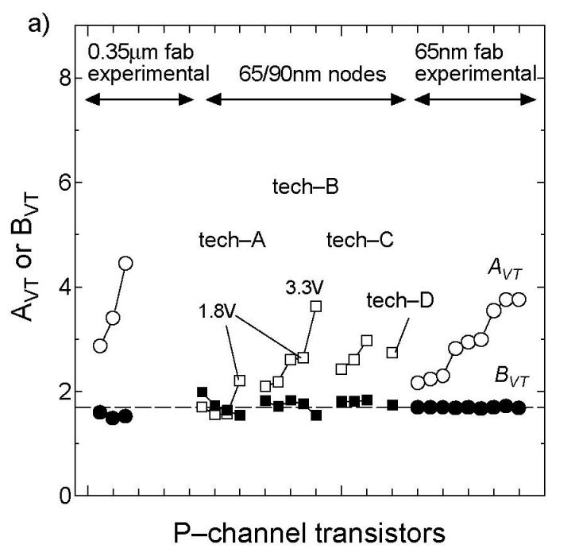
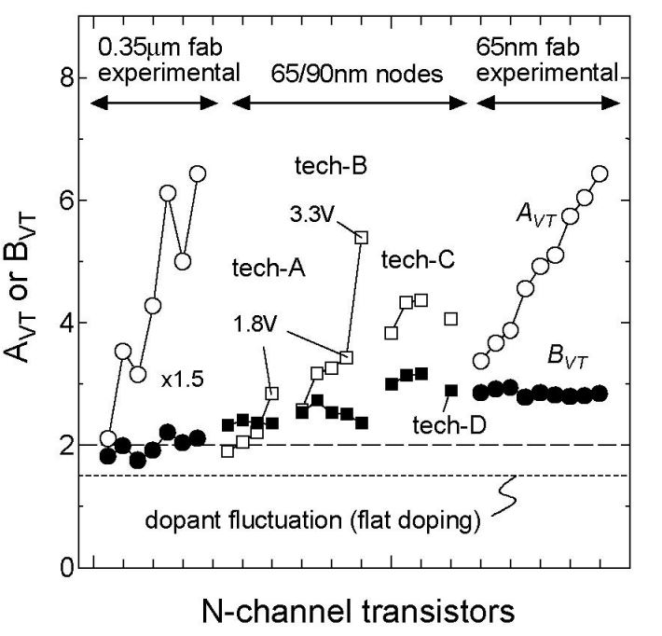


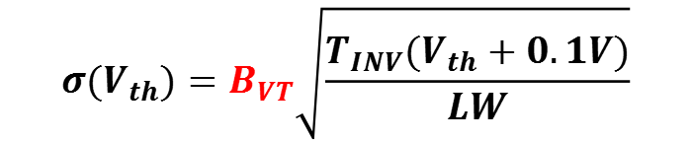
CMOS Process Variation
$$B_{VT}≈2.5$$
$$B_{VT}≈1.7$$
$$σ(V_{th})=B_{VT}\sqrt{\frac{T_{INV}(V_{th}+0.1V)}{LW}}$$
[2] K. Takeuchi et al., "Understanding Random Threshold Voltage Fluctuation by Comparing Multiple Fabs and Technologies," 2007 IEEE International Electron Devices Meeting, Washington, DC, 2007, pp. 467-470.
Notes:
In the fabrication process. The threshold voltage will have a random fluctuation accounting for dopant fluctuation. These fluctuations are following the Gaussian distribution. The standard deviation can be calculated by using this equation. A coefficient Bvt is a amonst constant in different technology node. In the pmos transistor. Bvt equals to 1.7. In the nmos transistor, Bvt equals to 2.5.

Slide 37
Power Consumption
1.8V
1.8V
BL₁
BL_{n}
LRS = 5.3kΩ
HRS = 100kΩ
First array’s R_{load}=20Ω
Other arrays’ R_{load}=30Ω
Power consumption:
About 2000nJ
WL₁
Cell
Cell
WLb₁
WL₂
SL
SL
WLb₂
LRS = 900kΩ
HRS = 10000kΩ
First array’s R_{load}=2kΩ
Other arrays’ R_{load}=3kΩ
Power consumption:
About 20nJ
WL_{n}
WLb_{n}
I₁ (BL current)
I_{n} (BL current)
R_{load}
R_{load}
Notes:
Presentation title:

Slide 38
Power Consumption
MNIST | TrueNorth [5] | CMOS [6] | SOC [7] | Processor [8] | DIMA [9] | Vesti [10] | ESF1 [4] | XUN [11] | Proposed circuit
Type | SNN |  | DNN | DNN (CNN) |  |  | BNN | DNN | BNN
technology | 45 nm | 28 nm | 28 nm | 40 nm | 65 nm | 65 nm | 180 nm | 180nm | 180 nm
Voltage supply | 0.6-0.8V | 0.9V | 0.6-1.1V | 0.55-1.1V | 1V | 1V | 2.7V | 1.8V | 1.8
#Hidden layer | 3 | 2 | 3 | AlexNet | LeNet-5 | 3 | 1 | 1 | 3
#Neurons/layer | 1280 | 256 | 256 |  |  | 256 | 64 | 64 | 512
Accuracy(%) | 99.42 | 98.7 | 98.5 | 99 | 99 | 98.3 | 94.7 | 94.8 | 96.76
Access time/ | 1000 | 10.92 |  | 74.63 | 14.29 | 0.116 | ~1 | 0.09 | 0.07
Energy/nJ | 108000 | 773 | 588 | 450 | 450 | ~12 (estimates) | ~20 (estimates) | ~17.25 (estimates) | ~20 (estimates)
Operational principle | von-Neumann |  |  |  | SRAM |  | FG |  | ReRAM
 |  |  |  |  | In-memory
Compared with von-Neumann, In-memory structure energy consumption and access time are lower.
ESFI [4] and the proposed circuit are both BNN structure. Compared with ESFI [4], the proposed circuit’s accuracy and access time are better.
Notes:
Presentation title:

Slide 39
Two-step training accuracy
Epoch=300
Weight: 1 or -1
σ_{Vth}=20mV

Slide 40
Reference
[4] S. Lee et al., "Operation Scheme of Multi-Layer Neural Networks Using NAND Flash Memory as High-Density Synaptic Devices," in IEEE Journal of the Electron Devices Society, vol. 7, pp. 1085-1093, 2019.
[5] S. K. Esser, R. Appuswamy, P. Merolla, J. V. Arthur, and D. S. Modha, “Backpropagation for energy-efficient neuromorphic computing,” Advances in Neural InformaBtion Processing Systems 28, C. Cortes, N. D. Lawrence, D. D. Lee, M. Sugiyama, and R. Garnett, Eds., pp. 1117–1125, 2015.
[6] S. Yin, S. K. Venkataramanaiah, G. K. Chen, R. Krishnamurthy, Y. Cao, C. Chakrabarti, and J. sun Seo, “Algorithm and Hardware Design of Discrete-Time Spiking Neural Networks Based on Back Propagation with Binary Activations,” IEEE Biomedical Circuits and Systems Conference (BioCAS), October 2017.
[7] P. N. Whatmough, S. K. Lee, H. Lee, S. Rama, D. Brooks, and G. Y. Wei, “A 28nm SoC with a 1.2GHz 568nJ/Prediction Sparse Deep Neural-Network Engine with >0.1 Timing Error Rate Tolerance for IoT Applications,” IEEE International Solid-State Circuits Conference (ISSCC), San Francisco, CA, USA, pp. 242-243, February 2017.

Slide 41
Reference
[8] B. Moons and M. Verhelst, “A 0.3-2.6 TOPS/W Precision-scalable Processor for Real-time Large-scale ConvNets,” IEEE Symposium on VLSI Circuits (VLSI-Circuits), Honolulu, HI, US, pp. 1–2, June 2016.
[9] M. Kang, S. Lim, S. Gonugondla, and N. R. Shanbhag, “An In-memory VLSI Architecture for Convolutional Neural Networks,” IEEE Journal on Emerging and Selected Topics in Circuits and Systems, vol. 8, no. 3, pp. 494–505, 2018.
[10] Z. Jiang, S. Yin, M. Kim, T. Gupta, M. Seok, and J. Seo, “Vesti: An In-Memory Computing Processor for Deep Neural Networks Acceleration,” 2019 53rd Asilomar Conference on Signals, Systems, and Computers, Pacific Grove, CA, USA, pp. 1516-1521, Nov. 2019.
[11] H. Xun, “Analog Neuromorphic In-memory Vector-Matrix Multiplier Based on Floating Gate Transistor Array Architecture,” master thesis, Waseda Univ., Feb. 2021.

